Slide 1
Topic: Statistics
EQ: What are the main measures of center we use and what are the benefits of each?

Slide 2
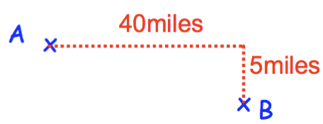
Topic: Statistics
EQ: What are the main measures of center and spread we use and what are the benefits of each?
Starter – Daily 5
Define ‘average’ i.e. – what is the average of your last 3 Maths test scores?
2. What is the difference between a similar triangle and a congruent triangle?
3. Calculate the direct length between A and B
4. Evaluate 4⁻²
5. Solve 2(4x – 1) = 18

Slide 3
Quickwrite
2 minutes
LEFT HAND SIDE of your Interactive Notebook
Write about the following two things:
1) Write down everything that comes to mind about the word ‘data’
2) What is an outlier?

Slide 4
Activity
- stand up, hands up, pair up
John purchased 5 computer games at a sale.
2 games cost $20 each, 2 games cost $30 each and 1 game cost $50
What do you remember about mean, median and mode?
2) Can you work out the mean, median and mode?
3) Which of the mean, median, mode gives the best ‘average’?
Notes:
Remind students how participate responsibly in this activity
Students in pairs work through each question (1 at a time)
Can swap partners between each question?

Slide 5
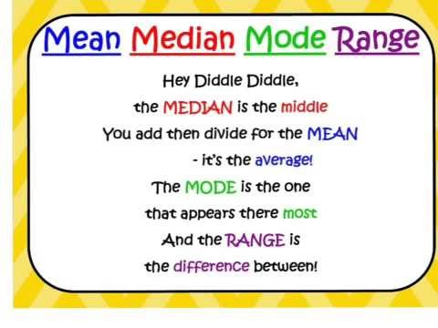

Slide 6
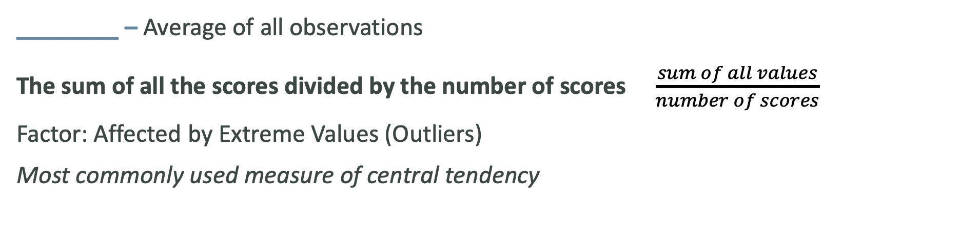
Topic: Statistics
EQ: What are the main measures of center and spread we use and what are the benefits of each?
The three most common measures of location are mean, median and mode?
________ – Average of all observations
The sum of all the scores divided by the number of scores $\frac{sum of all values}{number of scores}$
Factor: Affected by Extreme Values (Outliers)
Most commonly used measure of central tendency
Median – The ________ value of ordered data
If there’s an even amount of data, the median is the average of the two middle values.
Factor: Not Affected by Extreme Values

Slide 7
Topic: Statistics
EQ: What are the main measures of center and spread we use and what are the benefits of each?
Mode - The most frequently occurring value in the data
Factors
Not Affected by ________
There May Not be a Mode
There May be Several Modes
0 1 2 3 4 5 6 7 8 9 10 11 12 13
Mode = 9
Range is the difference between the largest and smallest values.
Range = ________________ – _________________
Mean, Median and Mode are measures of centre while Range is a measure of spread.

Slide 8
Topic: Statistics
EQ: What are the main measures of center and spread we use and what are the benefits of each?
Example
Diameter of 10 trees randomly selected from Kings Park:
9.8, 10.2, 10.1, 14.5, 17.5, 13.9, 20.0, 15.5, 7.8, 24.5
Mean
Median: 7.8, 9.8, 10.1, 10.2, 13.9, 14.5, 15.5, 17.5, 20.0, 24.5
(13.9 + 14.5) / 2 = 14.2
Mode
No Mode
Range 24.5 – 7.8 = 16.7

Slide 9

Do you understand? Quickfire Tips
What are 3 tips you could give someone who was trying to find measures of location/spread?
Notes:
Check For Understanding

Slide 10
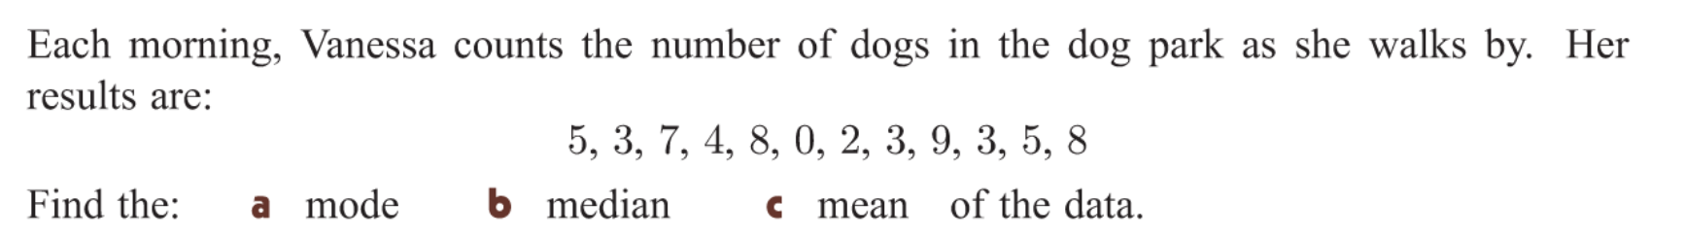
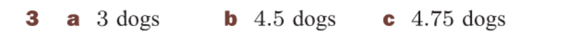
Task
YOUR TURN

Slide 11
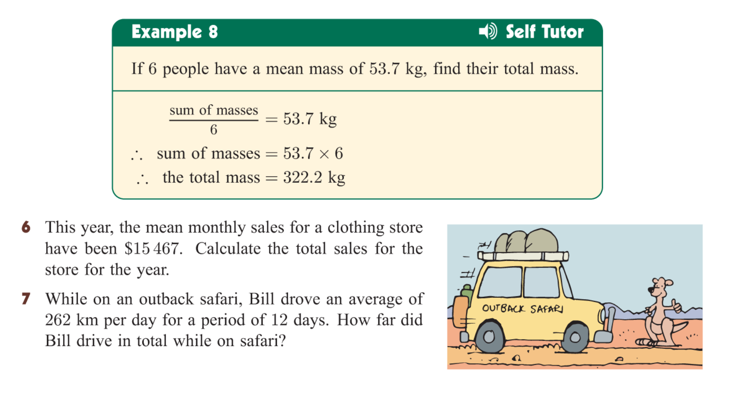
With the person next to you….. How would you solve it?

Slide 12

Practice
Mean Median Mode and Range Worksheet
Notes:
Independent practice

Slide 13
Exit ticket
Write a summary answering the essential question.
Add at least three new terms to your glossary

